Slide 1

AeroCity, Amritsar brings to you an all new escape from your regular lifestyle into the one that you have always dreamt of. Located on Ajnala Road (Airport Road), we offer you an integrated township for living in close knit communities. Designed by highly experienced, renowned architects and town planners, AeroCity provides world-class facilities in an ecosystem that is perfectly in-sync with your needs and aspirations.
PRESENTING A CONCEPT OF SMART AND SECURE LIVING
First of its kind, AeroCity is host to a fully integrated network by a reputed internet service provider giving the residents access to a free Wi-Fi system throughout the township along with unrestricted high-speed broadband cable access at every plot.
Furthermore, AeroCity gives a new definition to Secure Living by providing a multi-tiered round-the-clock security system with CCTVs across the township, a controlled access to the complex via a separate entry lane for residents using RFID tags and guests using intercom for verification.

Slide 2
RERA #
RERA # PBRERA-ASR02-PM0125
LICENSE #
1.DC-ADA/2018/39 Dt. 07.12.2018

Slide 3
FEW SALIENT FEATURES
Wi-Fi , Wireless, CCTV, Security, Fore walled Integrated Township
Only 1 Km to the Airport
Amritsar’s best Clubhouse managed professionally by a reputed Hospitality Group featuring
All weather heated swimming pool of the city.
GYM, Snooker, Table Tennis, Squash & Cards Room facilities ETC.
120’ wide roads and connecting Roads are of 60’& 40’ Ft
15-20 theme Parks close to 12 Acres
Dedicated bike lane and vehicle speed control mechanisms
3 Shopping centres for convenience
11 KM to Golden Temple

Slide 4
5 School Sites
Adequate water supply
1 Primary HealthCare Facility (2500 Sq. Yd.)
Underground Electricity Cables
Sewage Treatment Plant
Plot Size range from 150 - 730 square yards
Dedicated jogging and Cycle track
Eco friendly development including rainwater and energy harvesting
RFID tags / Automatic Boom Barriers dedicated lane for resident vehicles
10 km to ISBT Amritsar
8 Km to Railway Station

Slide 5
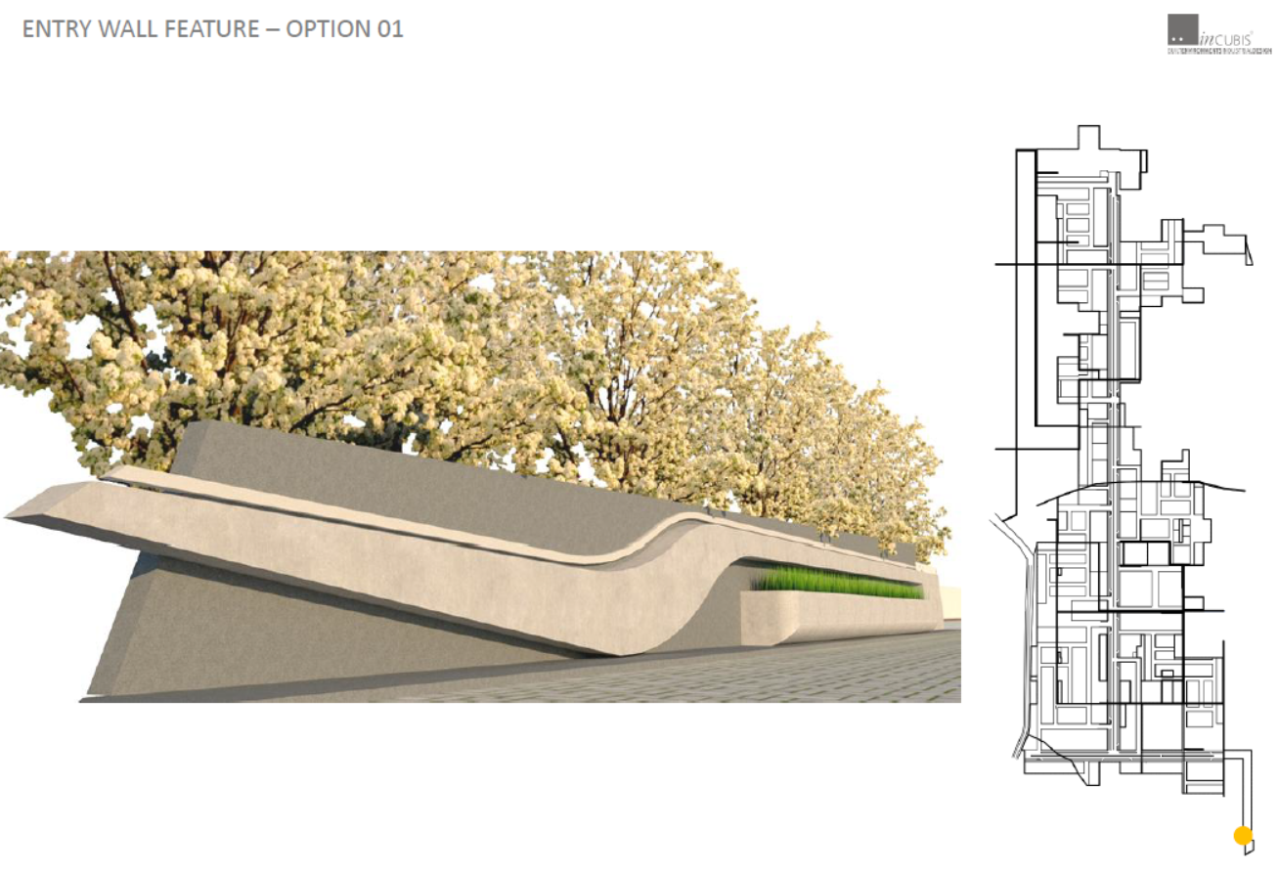
FEATURE ENTRY WALL 1

Slide 6
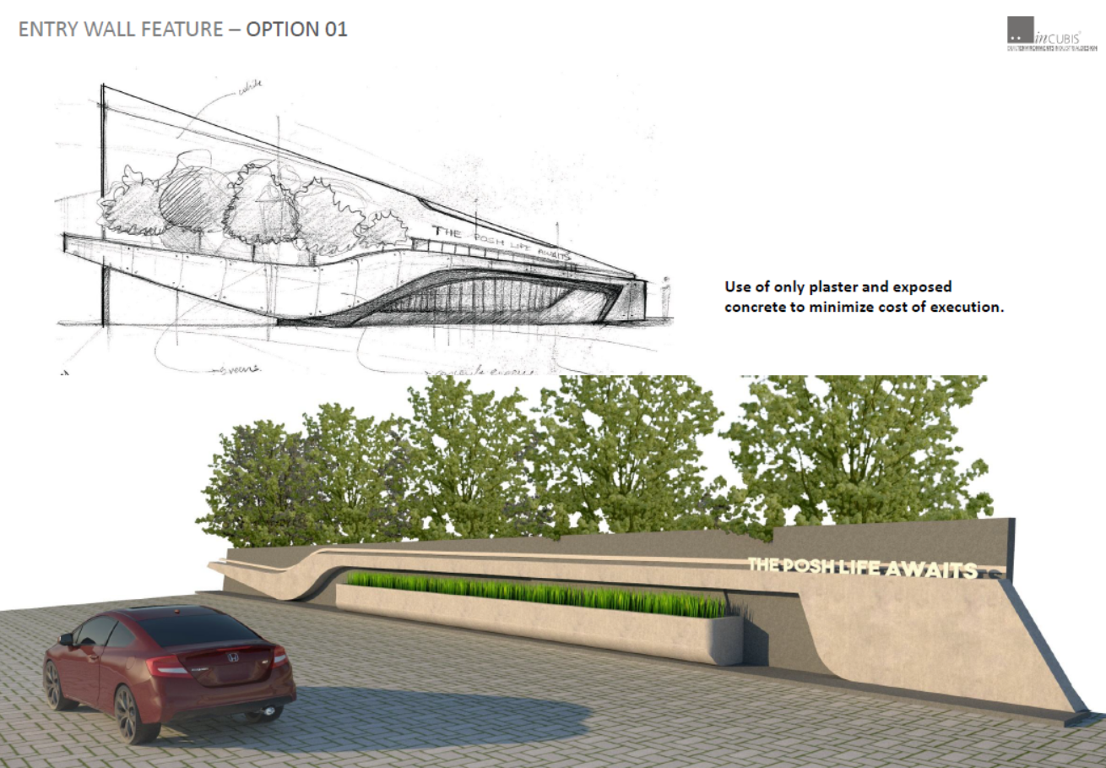
FEATURE ENTRY WALL 1

Slide 7
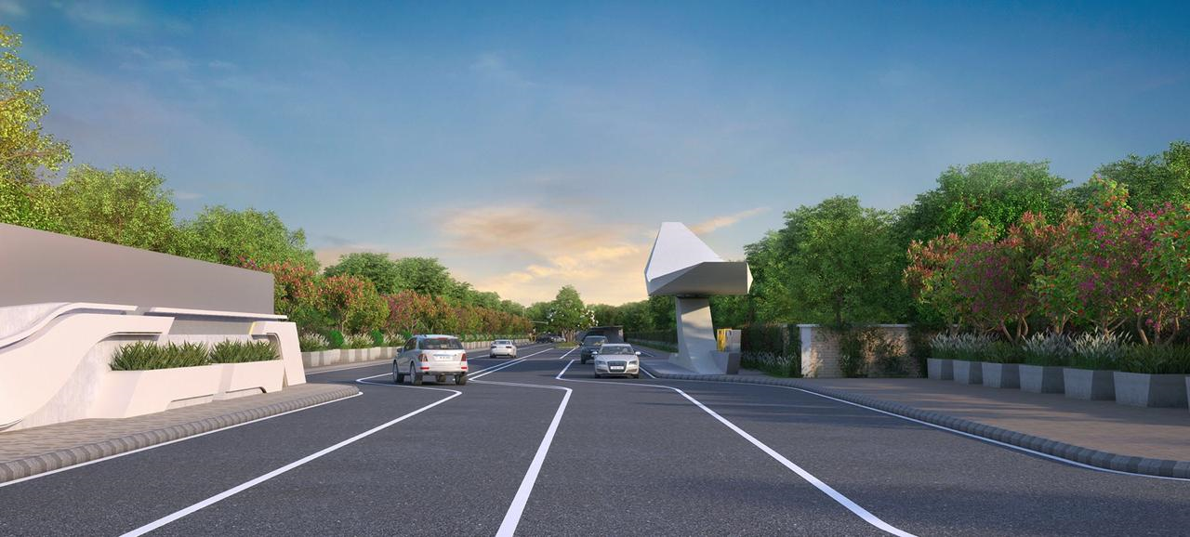
ENTERANCE 80 FEET ROAD

Slide 8
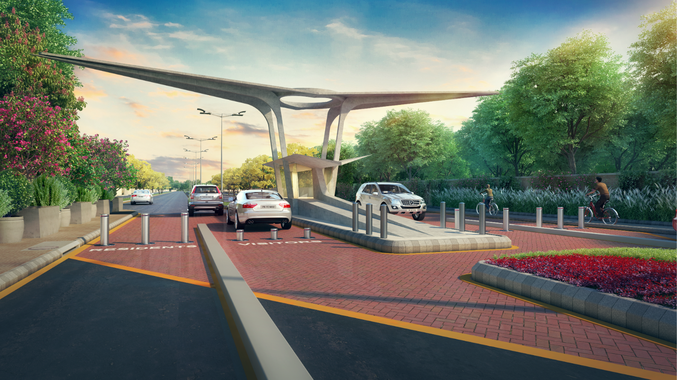
ENTRY GATE

Slide 9
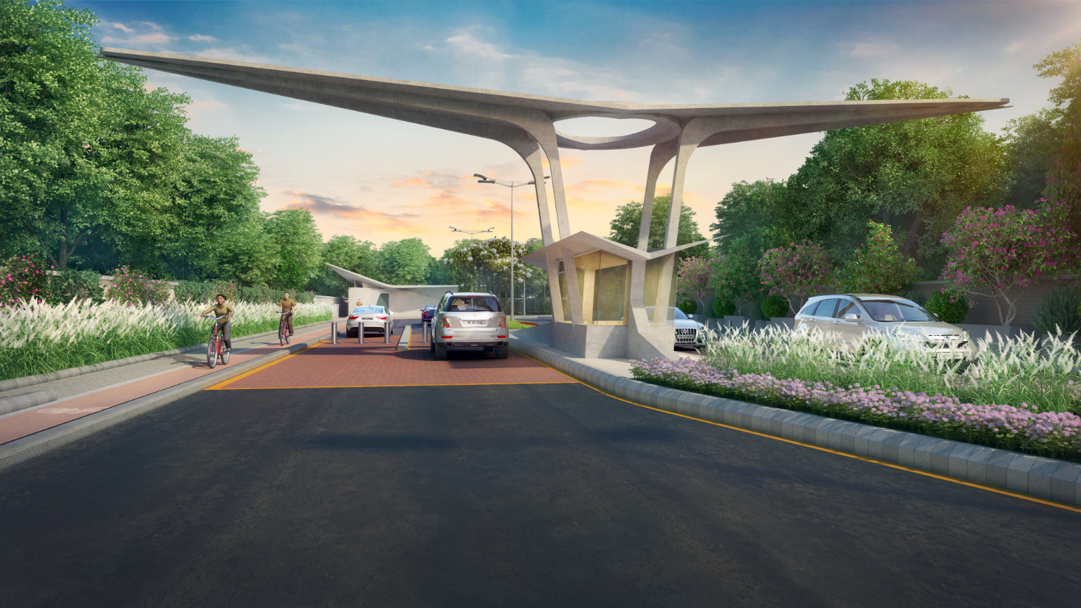
ENTRY GATE EXIT VIEW

Slide 10
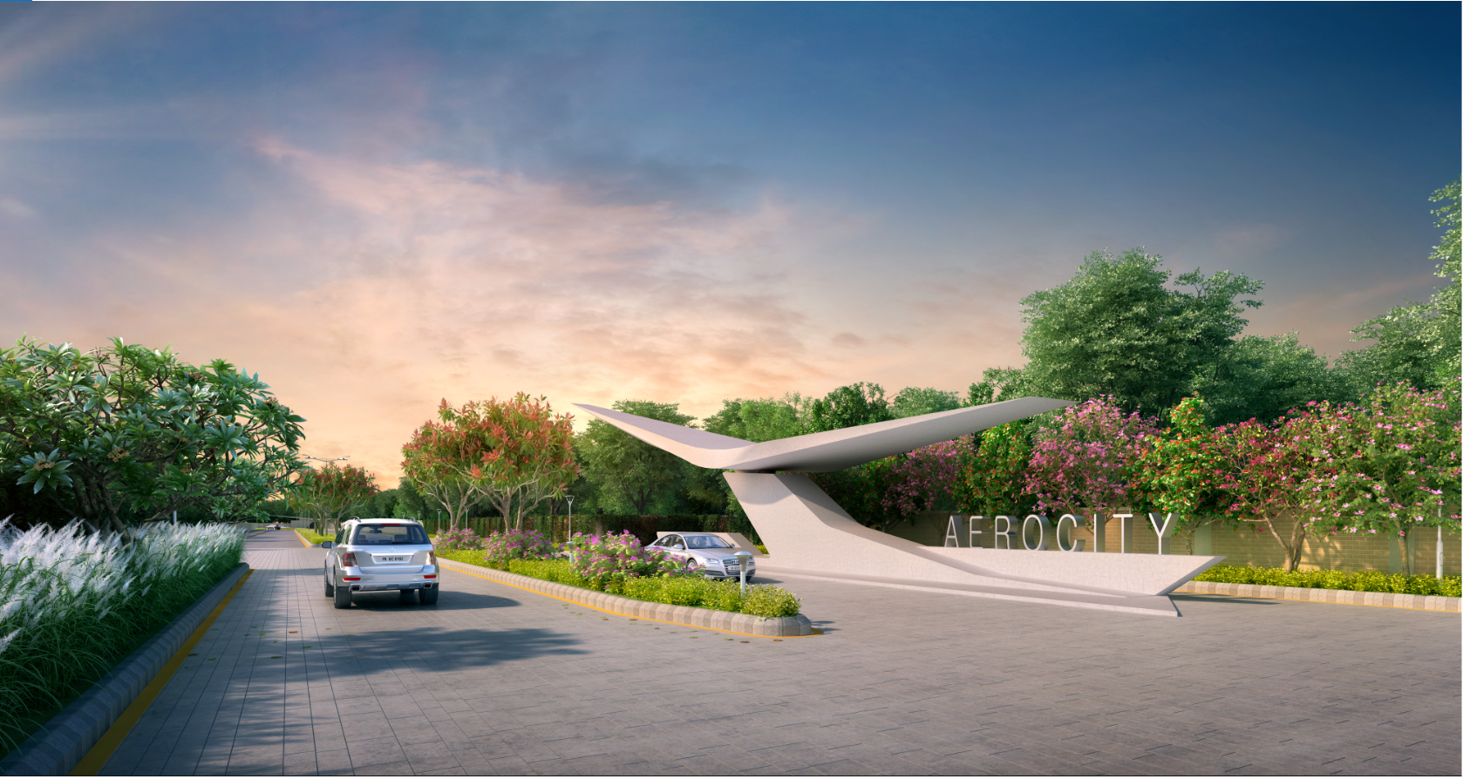
ELEMENTS

Slide 11
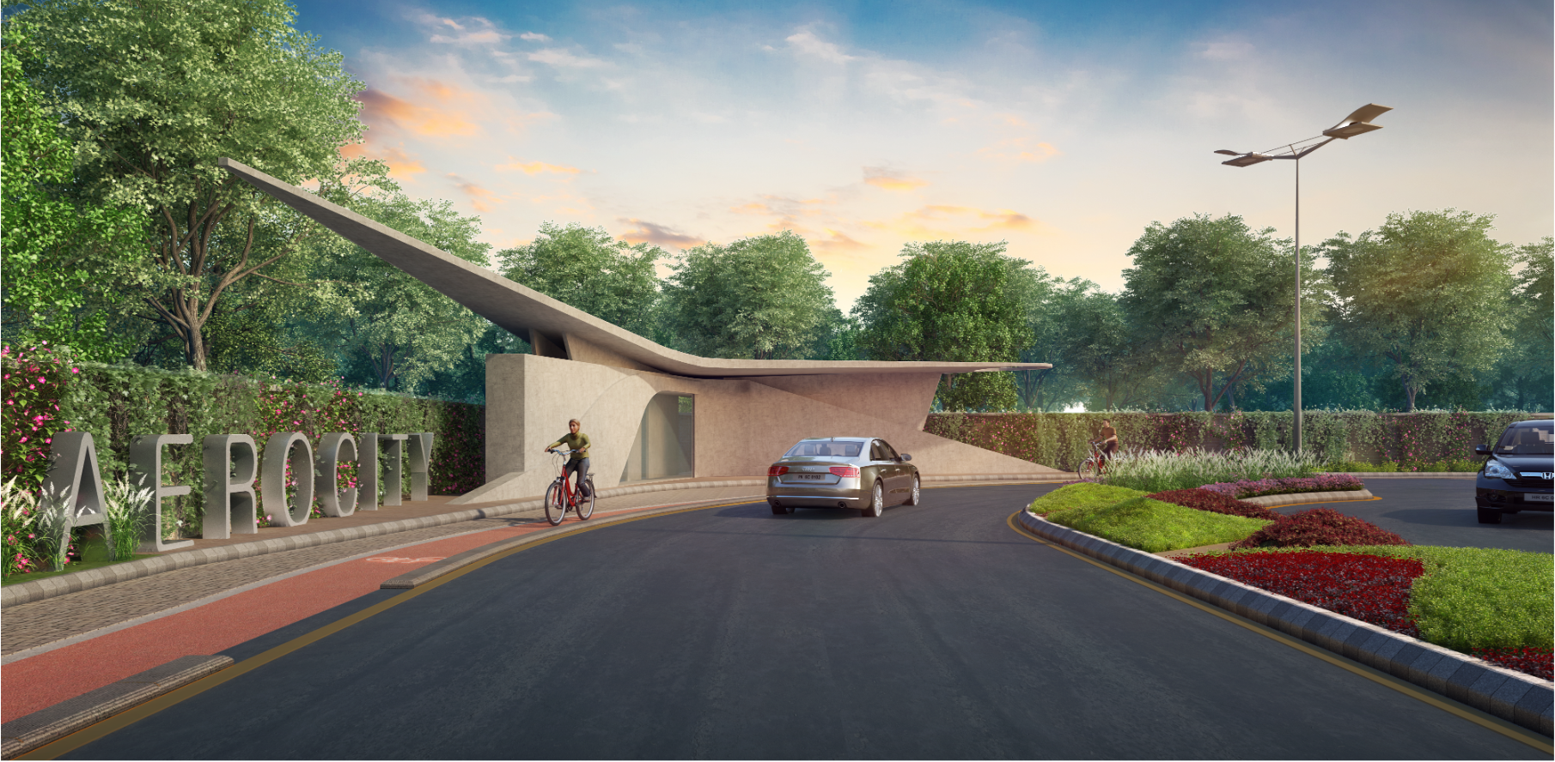
ELEMENTS

Slide 12
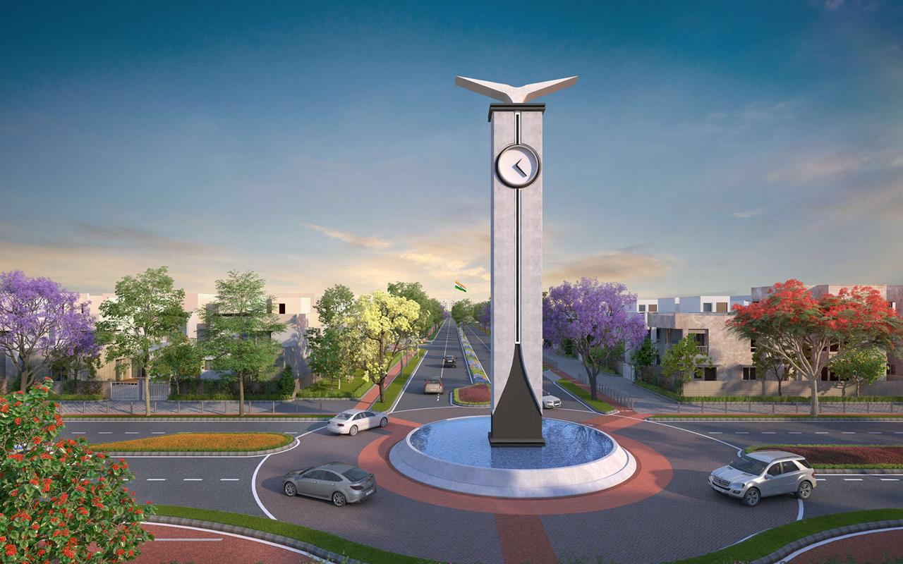
CLOCK TOWER

Slide 13
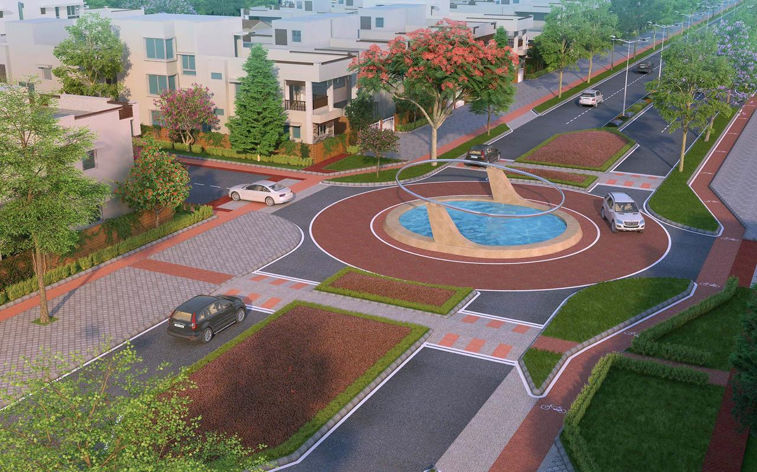
WATER HALO

Slide 14
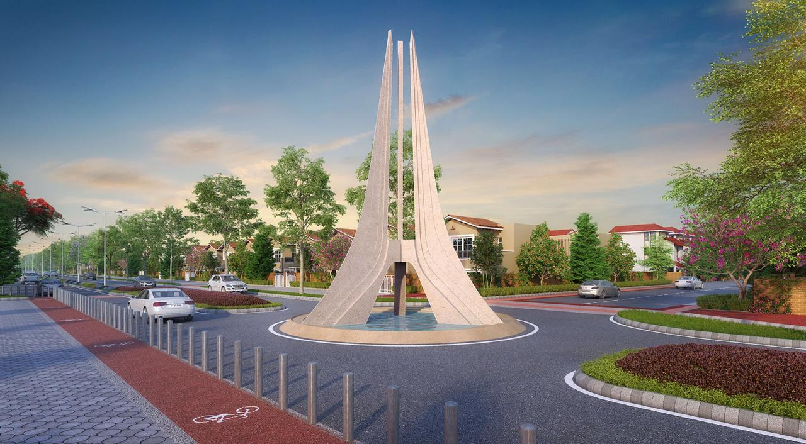
UNITY TOWER

Slide 15
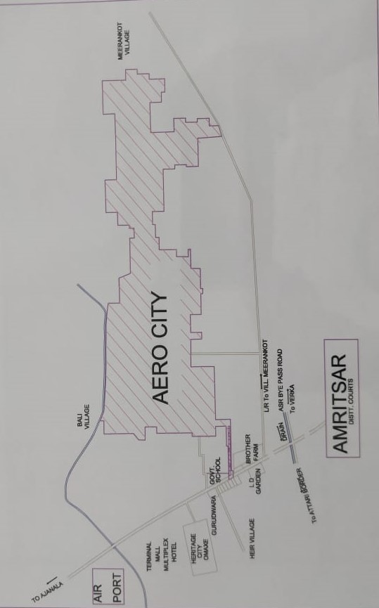
KEY PLAN

Slide 16
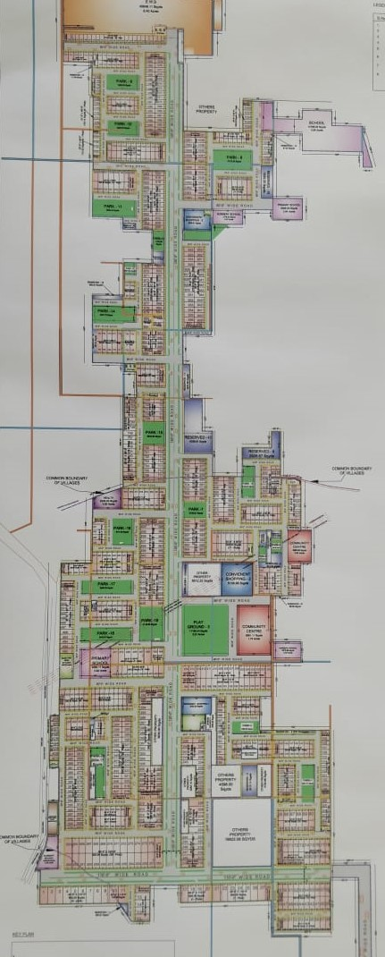
LAYOUT PLAN

Slide 17
THANK YOU

